Slide 1
Spring 2021
DATS 501 Fundamentals of Data Science
Hasan Demirtaş
hasan.demirtas@yeditepe.edu.tr
hdemirtas.academic@gmail.com
Cumhur Baştürk
basturkc.academic@gmail.com

Slide 2
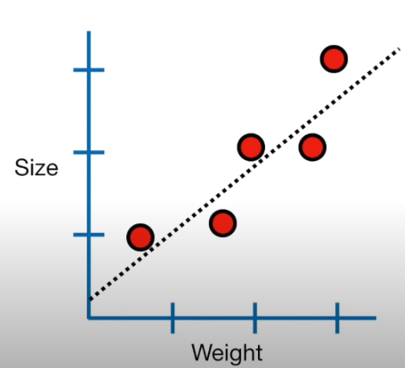
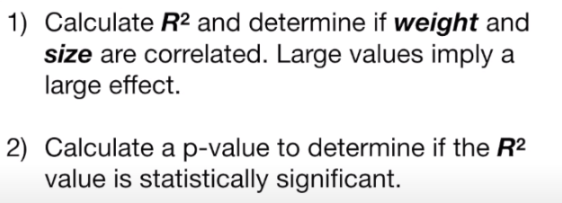
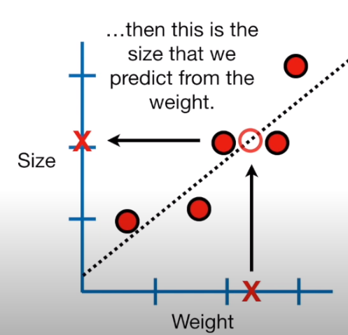
Linear Models
Simple Linear Regression

Slide 3
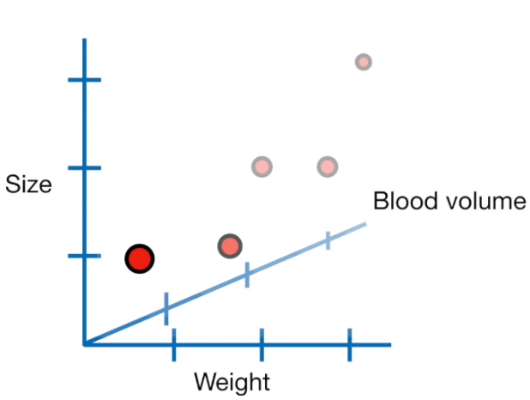
Linear Models
Multiple Linear Regression
Now, we are trying to predict size using weight and blood volume.

Slide 4
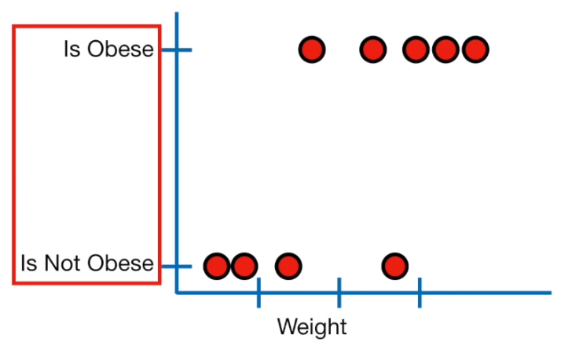
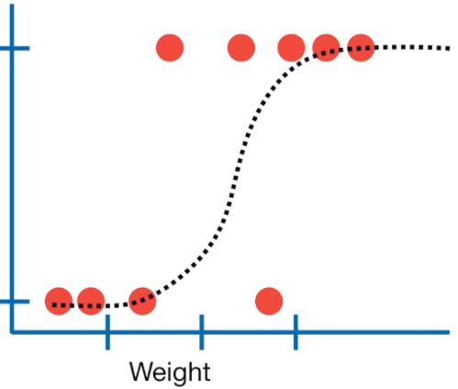
Logistic Regression
Logistic regression (LoR) is similar to linear regression
Difference is:
LoR predicts whether something is True or False, instead of predicting something continuous like size
Also, instead of fitting a line to the data, LoR fits «S» shaped «logistic function»
The curve goes from 0 to 1.
The curve tells the probability that a mouse
is obesed based on its weight.

Slide 5
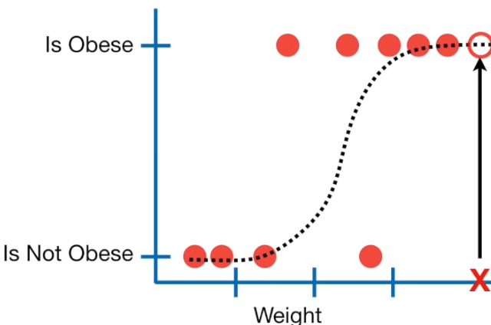
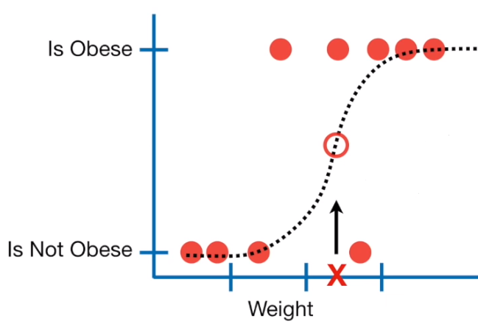
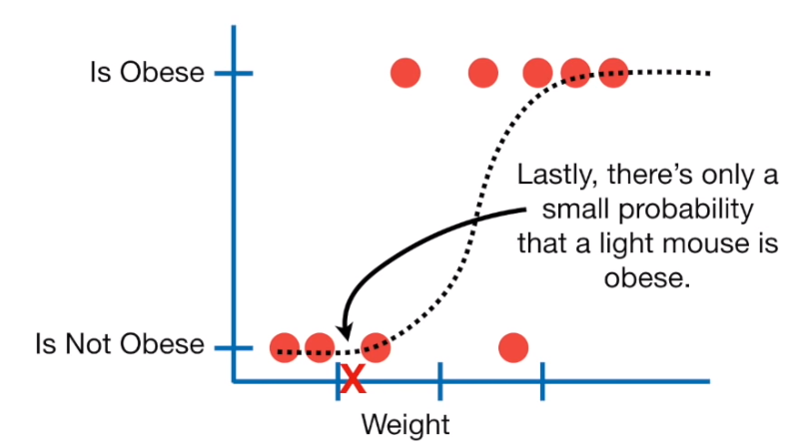
Logistic Regression
If we weighed a very heavy mouse, there is a high probability that the new mouse is obese.
If we weighed an intermediate mouse, there is only %50 chance that the new mouse is obese.

Slide 6
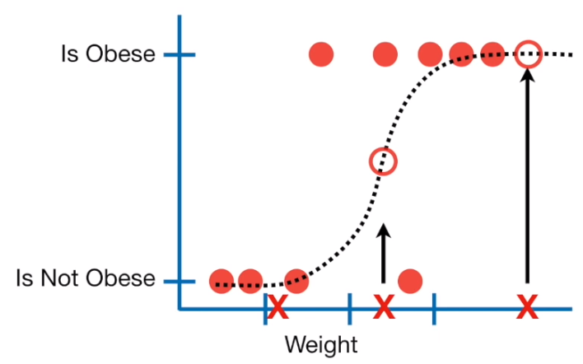
Logistic Regression
Although LoR tells the probability of a mouse is obese or not it’s usually usedfor CLASSIFICATION
For example, if the probability of a mouse is obese is > %50 then we'll classify it as "obese", otherwise "not obese"
Just like LR, we can make simple models...
Obesity is predicted by Weight
...or more complicated models...
Obesity is predicted by Weight + Genotype + Age + Astrological Sign
However unlike LR, we can't easily compare the complicated model to the simple model!!!

Slide 7
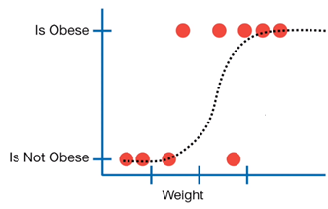
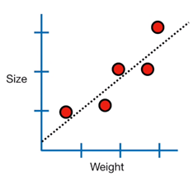
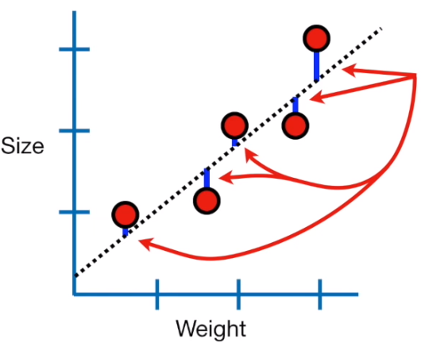
LR vs LoR
With LR, we fit the line using "least squares"
One big difference is how the line is fit to data
In other words, we find the line that minimizes RSS
We also use the residuals to calculate R2 and to compare simple models to complicated ones.

Slide 8
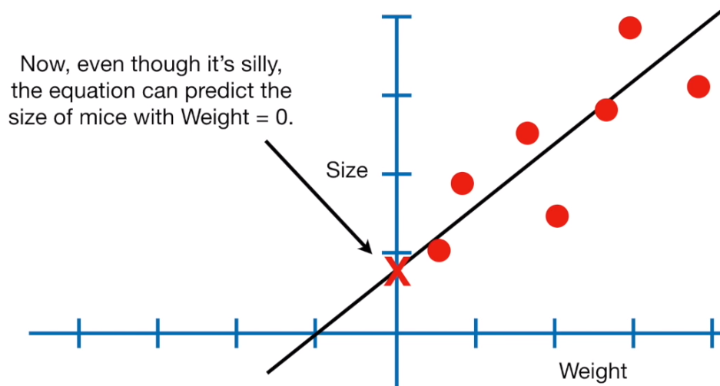
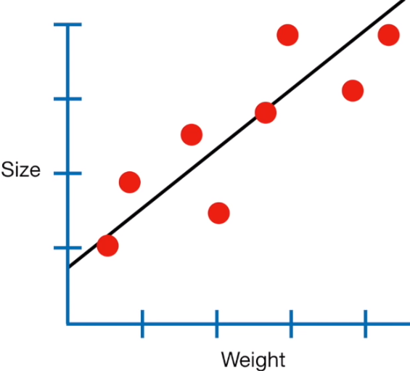
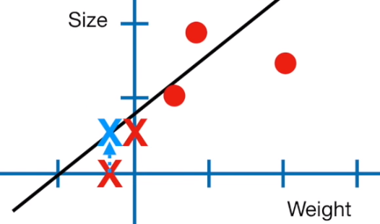
Coefficients of LoR
let’s have a look at the coefficients of LoR.
OK, we start from some data and fit a line.
and we can even predict the size of mice with negative weight!!!
size= 0.86 + 0.7 * weight
(the equation of the line)
I emphasize it, because the fact that we are not limiting the equation to a specific domain and range makes it easier to solve...
...and this has a big effect how LoR is done

Slide 9
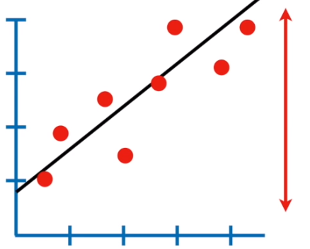
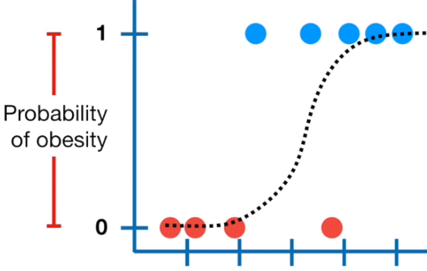
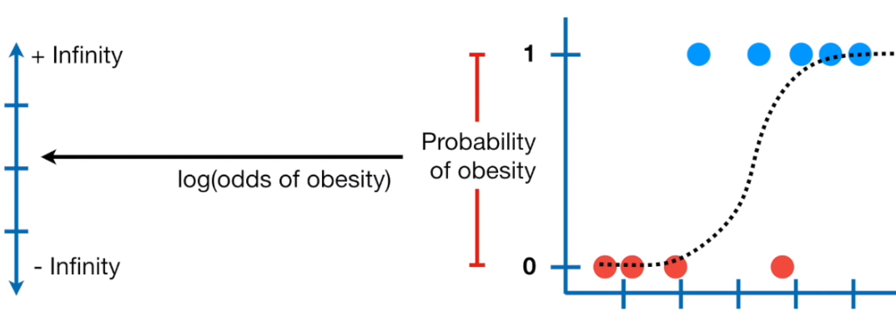
Coefficients of LoR
With LR, the values on the y-axis can ,in theory, be any number...
Unfortunately, with LoR, the y-axis is confined to probability values between 0 and 1
To solve this problem,
the y-axis in LoR is transformed from «probability of obesity» to «log(odds of obesity)»
So, just like the y-axis in LR,
it can go from "(-)infinity" to "(+)infinity"

Slide 10
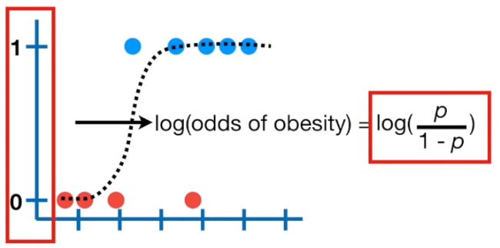
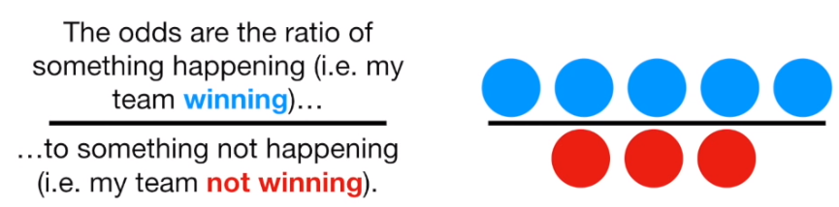
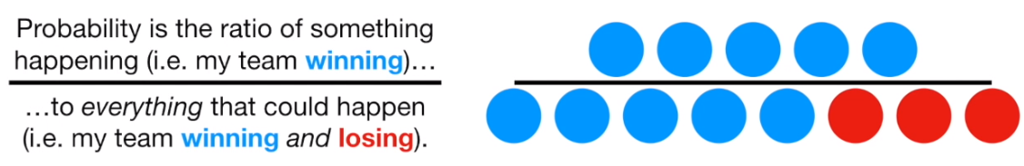
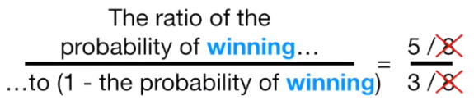
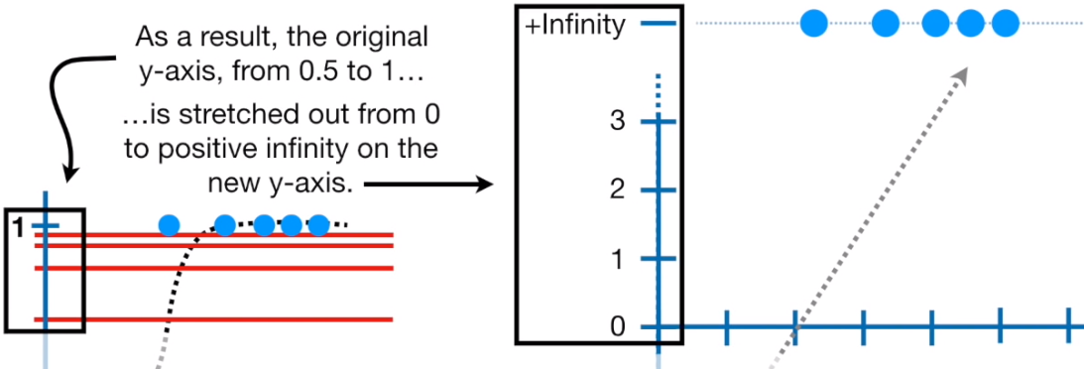
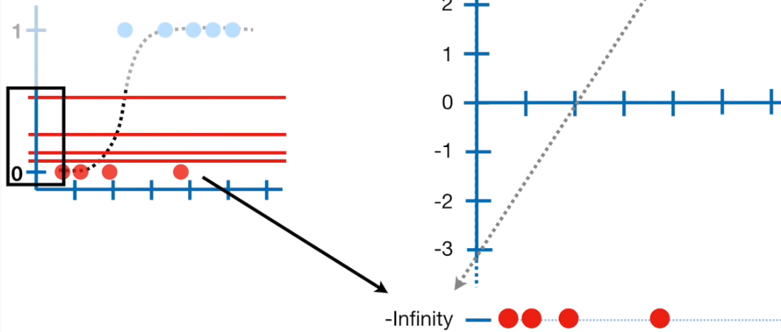
Coefficients of LoR
mid-point on the old y-axis corresponds to
p = 0.5
NOTE
p, in this case is the probability of a mouse being obese and corresponds a value on the old y-axis between 0 and 1.
p= 0.5 log(0.5 / (1-0.5)) = 0
p= 0.731 log(0.731 / (1-0.731)) = 1
p= 0.88 log(0.88 / (1-0.88)) = 2
p= 0.95 log(0.95 / (1-0.95)) = 3
p= 1 log(1) - log(0) = +infinity

Slide 11
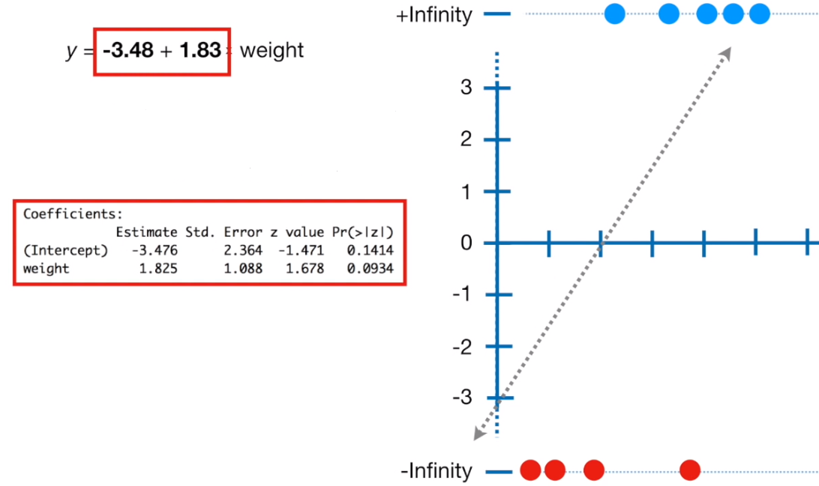
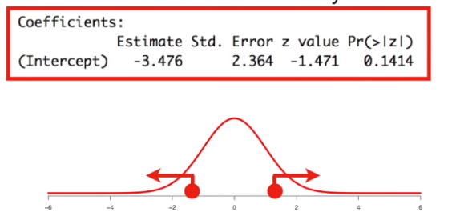
Coefficients of LoR
The coefficients for the line are what you get when you do logistic regression.
It means that interception is not statistically significant.
...and how about the slope ?
It means for every one unit of weight gained, log(odds of obesity) increases by 1.825
...also it means we can't reject Null Hypothesis, therefore we can omit variable «weight»
WOOOW!
It’s all because of our sample size!

Slide 12
Maximum Likelihood of LoR
In LoR, however, the relation between Y and x is nonlinear. So the least squares is
inappropriate for LoR.
– The dependent variable Y (or the residuals) doesn’t follow a normal distribution (Y is a categorical response variable and it takes only the values of 0 and 1,following a binomial distribution)
– The variance of Y is not constant across all classes (high variance for p near 0.5 and
lower variance towards 0 and 1)
LoR therefore uses the Maximum Likelihood Estimation method to estimate coefficients that maximize the probability of obtaining the training data.

Slide 13
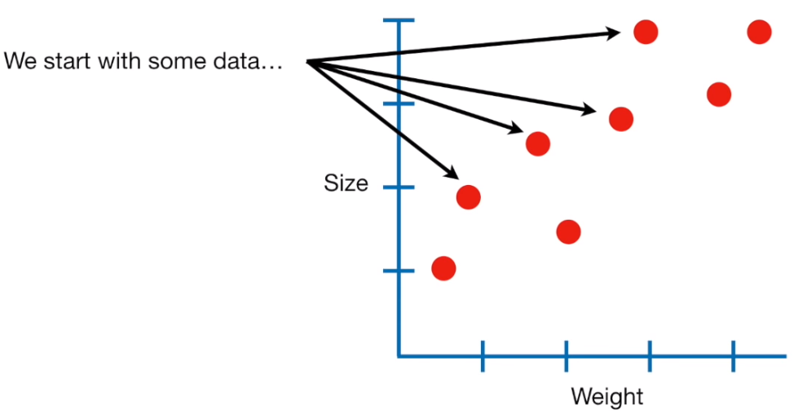
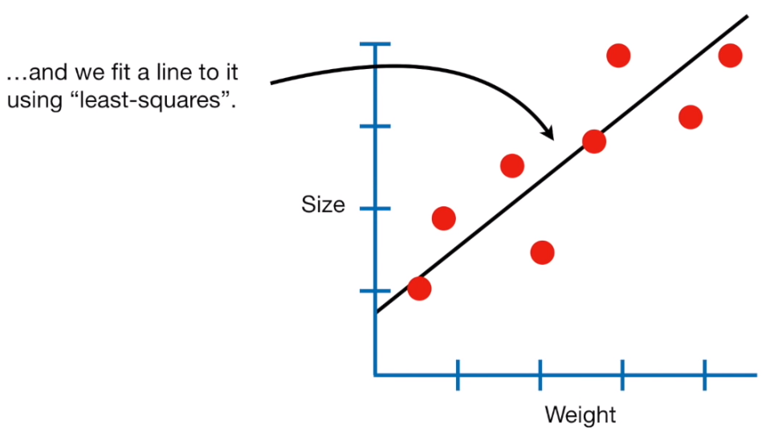
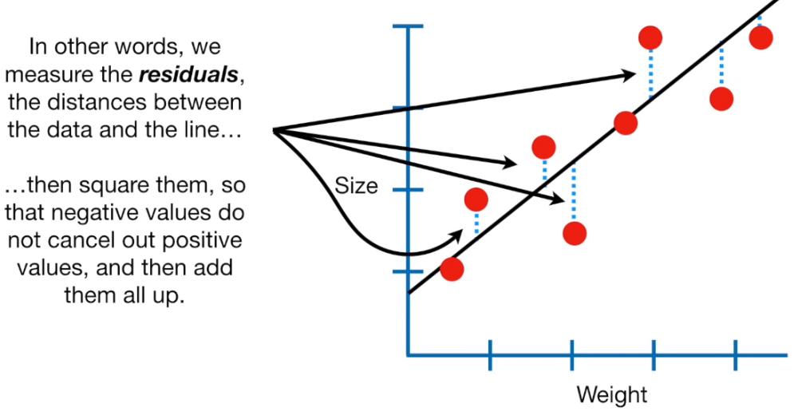
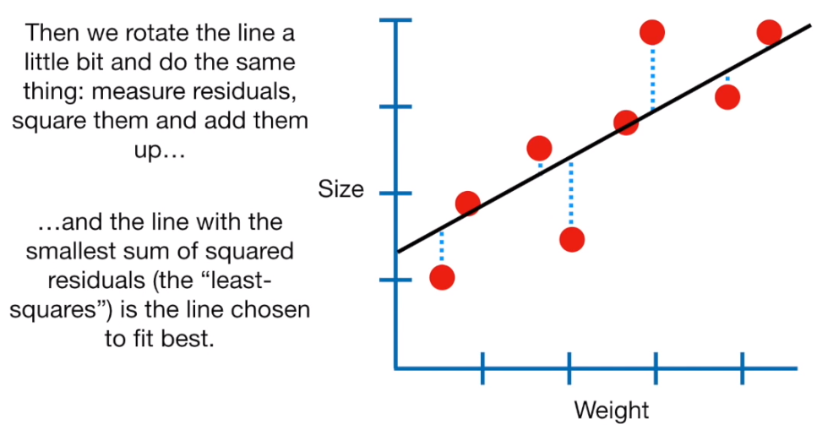
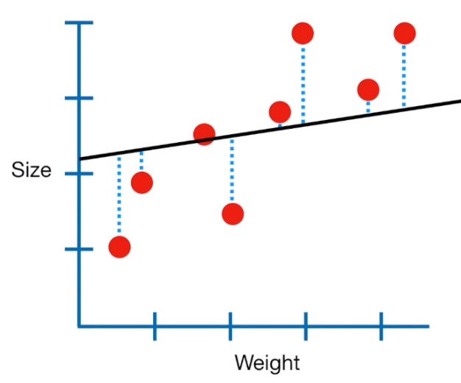
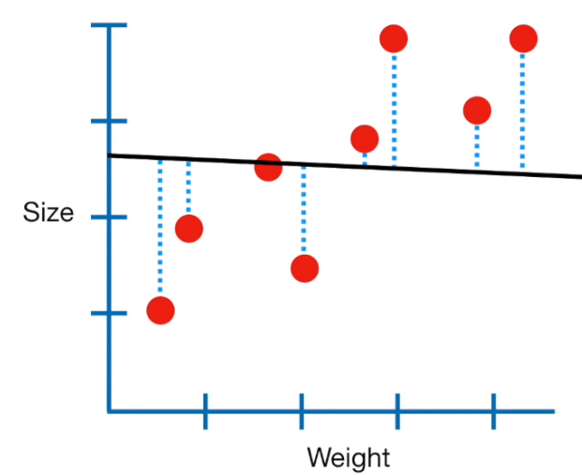
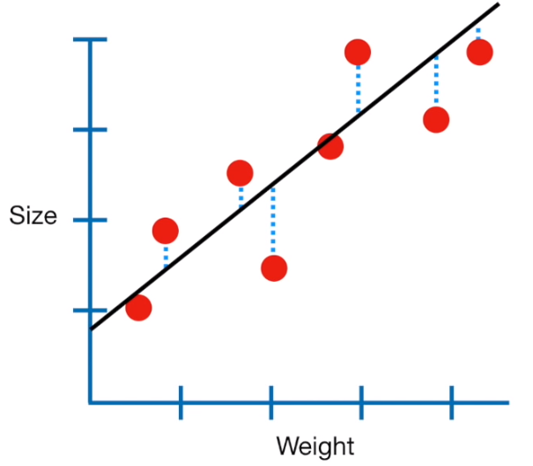
Maximum Likelihood of LoR
We remembered how to create "best fit line in LR", let's use LoR to determine the effect of weight on obesity.

Slide 14
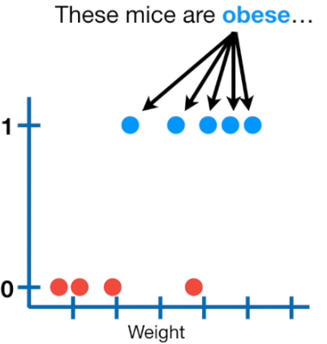
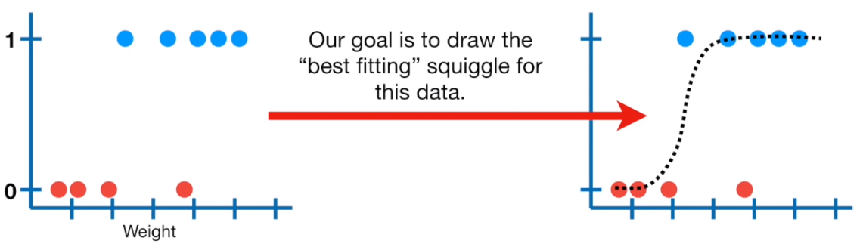
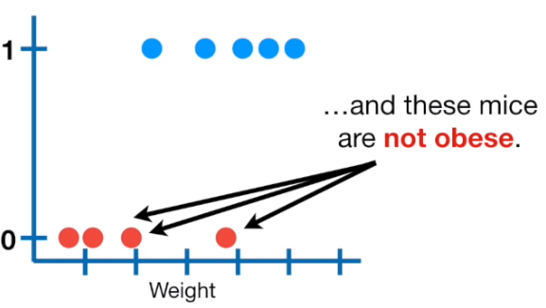
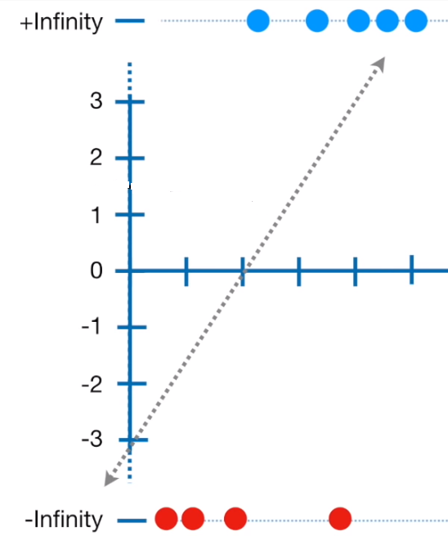
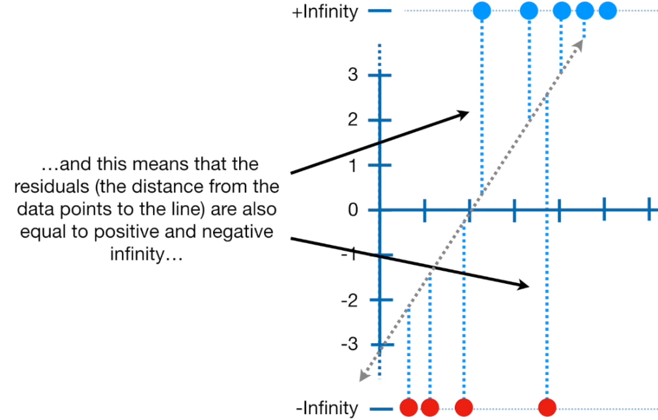
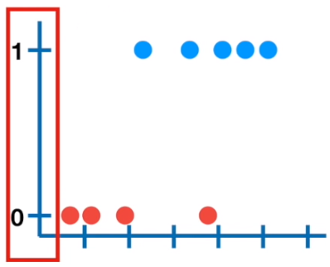
Maximum Likelihood of LoR
As we know, in LoR, we transform y-axis from the probability of obesity...
...to log(odds of obesity)
and draw a candidate
«best fitting line»
the only problem is that transformation pushes the raw data to +/- infinity
...this means we can't use «least squares» to find «the best fitting line»
instead we use «maximum likelihood»

Slide 15
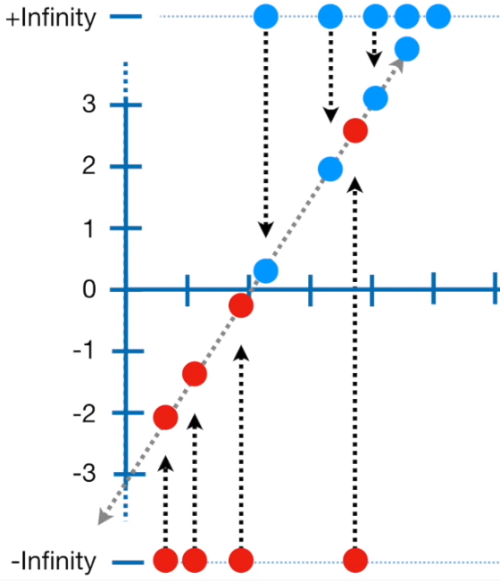
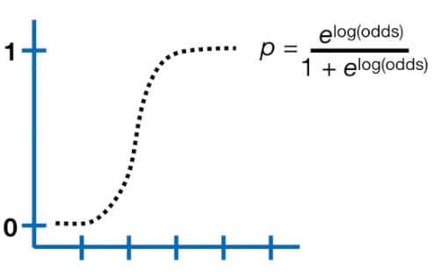
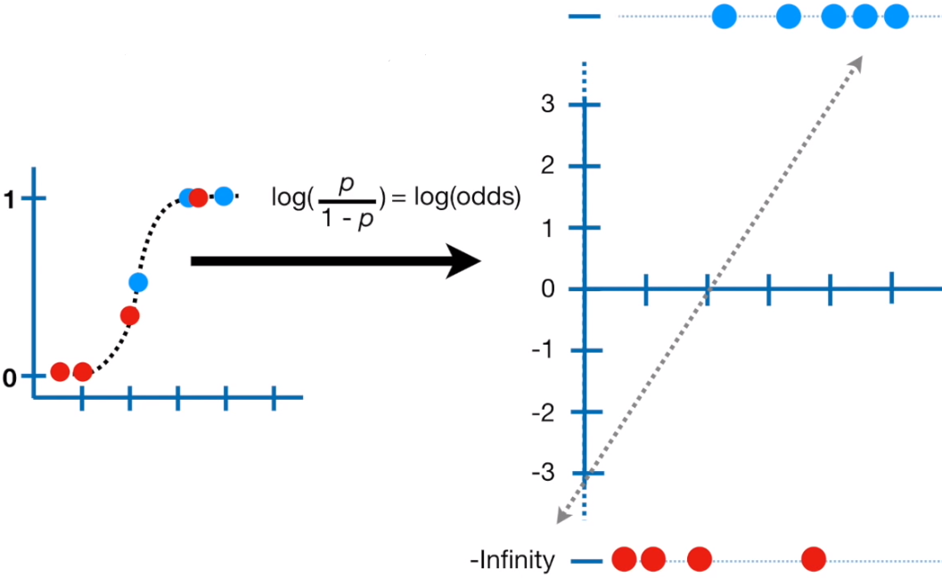
Maximum Likelihood of LoR
the first thing we do is project the original data points onto the candidate line.
...then we transform candidate log(odds) to candidate probabilities using this fancy looking formula
And just reordering of the transformation from probability to log(odds)...
this gives each sample a candidate log(odds) value
log(odds) of this point is -1.4
for example, log(odds) of this point is -2.1

Slide 16
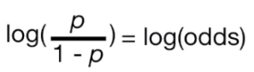
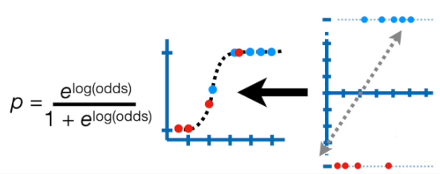
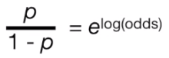
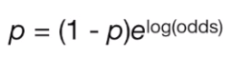
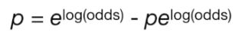
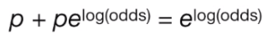
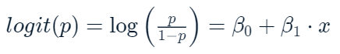

Logistic Regression
let's do some math!
it gives us LoR formula:

Slide 17




Logistic Regression
now, we use the observed status (OBESE or NOT OBESE) to calculate their likelihood given the shape of the squiggly line
in this case, the probability is not calculated as area under the curve,
but instead it is the y-axis value.that’'s why it is the same as likelihood.
Thus, for these mice:
the likelihood= (1 - probability the mouse is obese)
Although it is possible to calculate the likelihood as the product of the individual likelihoods,
statisticians prefer to calculate the LOG OF THE LIKELIHOOD instead.

Slide 18










Logistic Regression
if we rotate the line and calculate its log-likelihood by projecting data onto it
...and we just keep rotating the log(odds) line and projecting data onto it...
...and transforming it to probabilities and calculating the log-likelihood

Slide 19

Model Accuracy

Slide 20
Model Accuracy
What indicators do we use?
– Statistical measures (MSE, R2, etc.)
– Classification accuracy (how good is the model in predicting the unseen data)
– Confusion matrix (false positives, false negatives)

Slide 21




Logistic Regression
let's talk about classification accuracy...
If my model pays little attention to training data and oversimplifies the model and doesn't learn the patterns?
Memorizes all data points including noise?
OR

Slide 22
Logistic Regression
• A high-bias model: underfits the data set
• A high-variance model: overfits the data set
What I mean calling
BIAS is : the distance between the predictions of a model and the true values.
VARIANCE is: the amount that the estimate of the target function will change if different training data was used.
If Bias vs Variance was the act of reading,
it could be like Skimming a Text vs Memorizing a Text
Generally, linear algorithms have a high bias making them fast to learn and easier to understand but generally less flexible. In turn, they have lower predictive performance on complex problems that fail to meet the simplifying assumptions of the algorithms bias.

Slide 23

Logistic Regression
There is no escaping the relationship between bias and variance in machine learning.
-Increasing the bias will decrease the variance.
-Increasing the variance will decrease the bias.
There is a trade-off at play between these two concerns and the algorithms you choose and the way you choose to configure them are finding different balances in this trade-off for your problem

Slide 24

Confusion Matrix
What can we learn from this matrix?
There are two possible predicted classes: "yes" and "no". If we were predicting the presence of a disease, for example, "yes" would mean they have the disease, and "no" would mean they don't have the disease.
The classifier made a total of 165 predictions (e.g., 165 patients were being tested for the presence of that disease).
Out of those 165 cases, the classifier predicted "yes" 110 times, and "no" 55 times.
In reality, 105 patients in the sample have the disease, and 60 patients do not.
Let's now define the most basic terms, which are whole numbers (not rates):
true positives (TP): These are cases in which we predicted yes (they have the disease), and they do have the disease.
true negatives (TN): We predicted no, and they don't have the disease.
false positives (FP): We predicted yes, but they don't actually have the disease. (Also known as a "Type I error.")
false negatives (FN): We predicted no, but they actually do have the disease. (Also known as a "Type II error.")

Slide 25
Confusion Matrix
This is a list of rates that are often computed from a confusion matrix for a binary classifier:
Accuracy: Overall, how often is the classifier correct?
(TP+TN)/total = (100+50)/165 = 0.91
Misclassification Rate: Overall, how often is it wrong?
(FP+FN)/total = (10+5)/165 = 0.09
equivalent to 1 minus Accuracy
also known as "Error Rate"
True Positive Rate: When it's actually yes, how often does it predict yes?
TP/actual yes = 100/105 = 0.95
also known as "Sensitivity" or "Recall"
False Positive Rate: When it's actually no, how often does it predict yes?
FP/actual no = 10/60 = 0.17
True Negative Rate: When it's actually no, how often does it predict no?
TN/actual no = 50/60 = 0.83
equivalent to 1 minus False Positive Rate
also known as "Specificity"
Precision: When it predicts yes, how often is it correct?
TP/predicted yes = 100/110 = 0.91
Prevalence: How often does the yes condition actually occur in our sample?
actual yes/total = 105/165 = 0.64
*Null Error Rate: This is how often you would be wrong if you always predicted the majority class. (In our example, the null error rate would be 60/165=0.36 because if you always predicted yes, you would only be wrong for the 60 "no" cases.) This can be a useful baseline metric to compare your classifier against.

